Slide 1
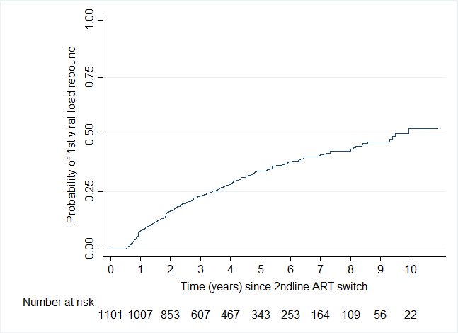
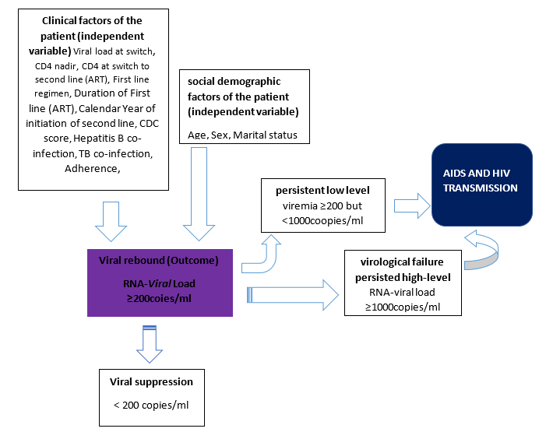
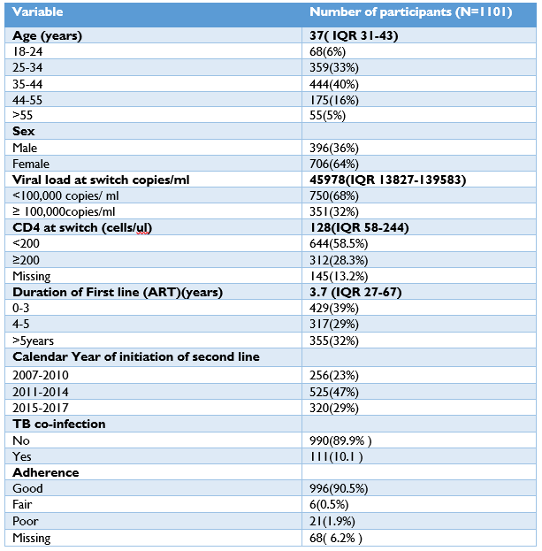
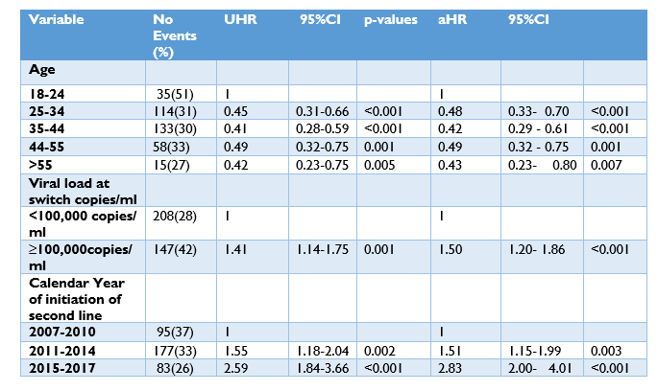
Durability of second-line anti-retroviral therapy and predictors of viral rebound among HIV patients on second-line ART in an HIV specialist clinic in Uganda: A 10-year retrospective cohort
I. Lumu^{1, 2, 3,} C. Sekaggya¹, J. Musaazi¹, S. Tomini², B. Castelnuovo¹
1Infectious Diseases Institute, Makerere University College of Health Sciences, Kampala, Uganda, 2University of Liverpool, School of Medicine, Liverpool, United Kingdom, 3University of Edinburgh, College of Medicine and Veterinary Medicine, Edinburgh, United Kingdom
BACKGROUND:
It is projected that up to 19.6% of patients on ART in Sub-Saharan Africa will need second-line treatment by 2030, but the durability(long term effectiveness) of such therapy has not been well studied.
This study investigated the durability(long term effectiveness) of second-line ART and the factors associated with the viral rebound in patients on second-line ART in Uganda.
RESULTS:
1101 participants were enrolled, 96% reported good adherence, 64% were female, the median age was 37 years (IQR 31-43), median duration on first-line ART was 3.7 years (IQR 2.7-6.7), and the median CD4 and viral load were 128 cells/ul (IQR 58-244) and 45978 copies/ml (IQR 13827-139583) respectively( see table 1)
Figure 2: Kaplan-Meier plot for the probability of having first viral load rebound
Figure 1: Conceptual framework of the study
Table 1: Demographic and clinical characteristics of the participants
Table 2: Univalent and multivariate, cox-proportional analysis
MORE RESULTS:
During the 4454.17 person-years, the incidence density of viral rebound was 79.70 (95% CI 71.83- 88.44) per 1000 person-years. The probability of a viral round at 5 and 10 years was 0.34, 95% CI (0.31 -0.37) and 0.5250, 95% CI (0.46 -0.60), respectively. The durability of second-line ART estimated as the median survival was 9.47 years(see figure 2).
Older age categories were protective against viral rebound, but a high switch viral load ≥100,000copies/ml was associated with viral rebound aHR 1.5, p-value < 0.001, 95% CI (1.20- 1.86). Also, later calendar years were associated with viral rebound aHR1.51, 95% CI (1.15-1.99), p-value< 0.003 for 2011-2014 and aHR 2.83, p-value< 0.001, 95% CI (2.00-4.01) for 2015-2017( see table 2)
METHODOLOGY:
Retrospective review of electronic records of patients initiated on second-line ART in an adult HIV clinic.
Patients that had taken second-line for ≥6 months between 2007 and 2017 were included. These patients were followed until they experienced a viral rebound (Viral load ≥200copies/ml), death, lost to follow-up or censored on 31st/12/2017 which ever occurred first.
Cumulative probability of experiencing a viral rebound and factors associated with viral rebound were determined using Kaplan-Meier methods and Cox proportional hazard models, respectively.
CONCLUSION:
The study affirms that among patients with good adherence in Uganda, second-line regimens are durable, and 50% of patients switched to second-line survive for 9.5 years without experiencing a viral rebound.
Meanwhile, a high switch viral load and later calendar year are significantly associated with a viral rebound, suggesting a need for closer follow-up of at-risk individuals in order to maximise the durability of second-line ART
ABSTRACT NUMBER: PEB0256
PRESENTED AT THE 23RD INTERNATIONAL AIDS CONFERENCE (AIDS 2020) | 6-10 JULY 2020

